Slide 1
Objective of the project :
•To ensure security of any kind of houses, hospitals, apartments and institutions.
•Save from unwanted situations by getting alarm.
•For betterment and digitalization

Slide 2
Security alarm control system (Proposed System)
The Security Alarm Control System is a platform that improves efficiency at workplaces or industries by ensuring alarms are handled quickly and by notifying appropriate staff via 555 timer and wireless devices
This circuit is very useful in homes, banks, shops, restricted areas where an alert alarm is needed on any movement.

Slide 3
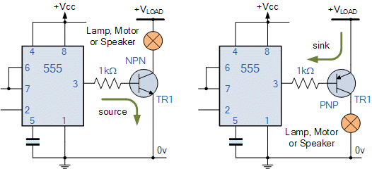
Components:
Proteus (for simulation)
LED and Photodiode
Wires
555 timer IC
IC LM358
Resistor 10M, 500k, 500k,
Capacitor 10uF
Variable resistor
Buzzer
Battery
On/off switch

Slide 4
The 555 timer in a circuit:
The 555 timer chip is extremely robust and stable 8-pin device that can be operated either as a very accurate Monostable, Bistable or Astable Multivibrator to produce a variety of applications such as one-shot or delay timers, pulse generation, LED and lamp flashers, alarms and tone generation, logic clocks, frequency.
This circuit is designed to alert the user when an intruder enters into the home. If there is any obstacle in front of IR sensor, it generates an interrupt signal. This interrupt signal is given to the speaker to alert the user.

